Slide 1
UFT API Testing Overview
April 2016

Slide 2
Agenda
What is API Testing
Challenges of API Testing
UFT API Test
Demo
Q&A

Slide 3
What is API Testing
A Typical Simple API (Application Programming Interface))
int GetResult( int a, int b, string op );
No UI to test
Concentrates on the business logic layer

Slide 4
What to Test?
int GetResult(int a,int b, string op);
Valid values of a and b and op
Boundary values of a and b
Boundary values of the result
Overflow values of the result
Invalid values of op, including string overflows
Null values of op
Security

Slide 5
Who Tests?
int GetResult(int a,int b, string op);
Typically, developers write unit tests to cover some of the possible situations
But unit testing is white-box, and limited to a given unit
Who does the black-box testing?
Who does the integration testing?
Who does the capacity and load testing?

Slide 6


Challenges of Testing API
QA
Developer
When’s the GUI gonna be ready?
I’m on it…
Need to test early, can’t wait for UI
Notes:
Iftach
Organizations need to test early – Can’t wait for UI

Slide 7

Challenges of Testing API
QA
Developer
Wait, I don’t get it…
Did you read the documentation?
QA needs to get more information from Dev
Notes:
QA needs to get more information from Dev, and quickly

Slide 8
Challenges of Testing API
QA
Developer
There’s no UI! How am I supposed to test it???
Just test the service directly!
If there’s no UI, need to test service directly
Notes:
Sometimes there’s no UI – you need to test the service directly

Slide 9

Challenges of Testing API
QA
Developer
It doesn’t conform to the standard!
Oh, just open a defect on it.
Services need to conform to standards
Notes:
Services need to conform a standard

Slide 10
Challenges of Testing API
QA
Developer
Hey, you broke the interface!
Hmm. It works on my machine…
Services are fragile, and can be broken easily
Notes:
Services are fragile – a service can be broken if a dependent service changes

Slide 11


Challenges of Testing API
QA
Developer
Yay! I managed to hack the service!
اوه نه! اسرائیل هکرها!
Services are vulnerable, as anything can be passed in
Notes:
Services are vulnerable – you can pass anything into a service
(Persian text: ‘Aw nah! Israeil h’karha’ “Oh no! Israel hackers!”)

Slide 12
Challenges of Testing API
QA
Developer
How can I test the whole process?
Use Unified Functional Testing!
Applications need to be tested end-to-end
Notes:
Applications need to be tested end to end

Slide 13
Challenges of API Testing (Summary)
Need to test early, can’t wait for UI
QA needs to get more information from Dev
If there’s no UI, need to test service directly
Services need to conform to standards
Services are fragile, and can be broken easily
Services are vulnerable, as anything can be passed in
Applications need to be tested end-to-end

Slide 14
UFT API Test (former Service Test)
Allow testing many technologies
Web Services (SOAP, REST)
JMS (Java Message Service)
IBM MQ, IBM Websphere, Weblogic, Tibco, Apache ActiveMQ,…..
Databases
…..
Creation of custom code in C# to enable custom testing

Slide 15
UFT API Test (former Service Test)
Drag and Drop UI
Powerful Data Handling
Integration ALM/LR
Extensible Framework
Validate with Checkpoints
Flexible Custom Codes

Slide 16
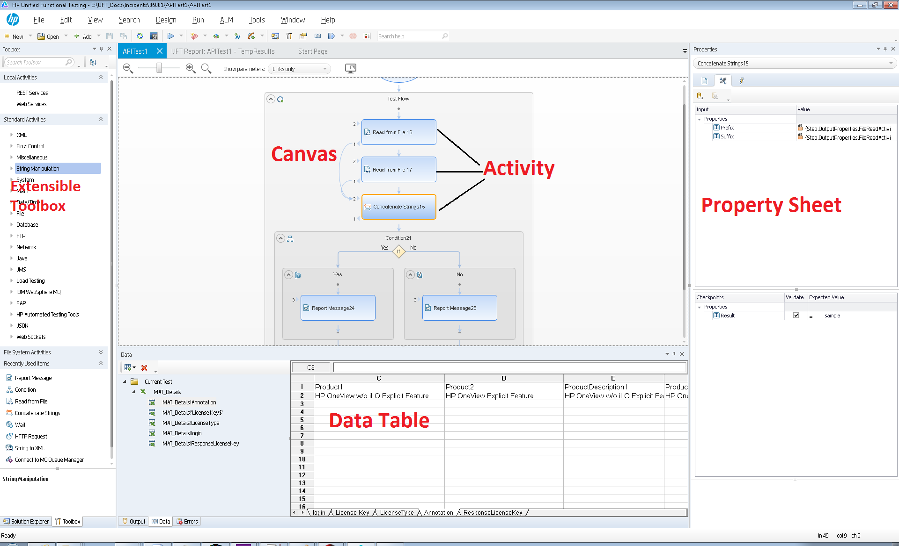
API Testing designer

Slide 17
Demo
Let say we have a web service: HP Flights and want to test it by UFT
Prerequisite: a WSDL content (get from URL or from File)
From WSDL content, UFT parses and creates methods into Activities for testing
Use these activities and design the test cases

Slide 18
Thank you for listening!

